Slide 1
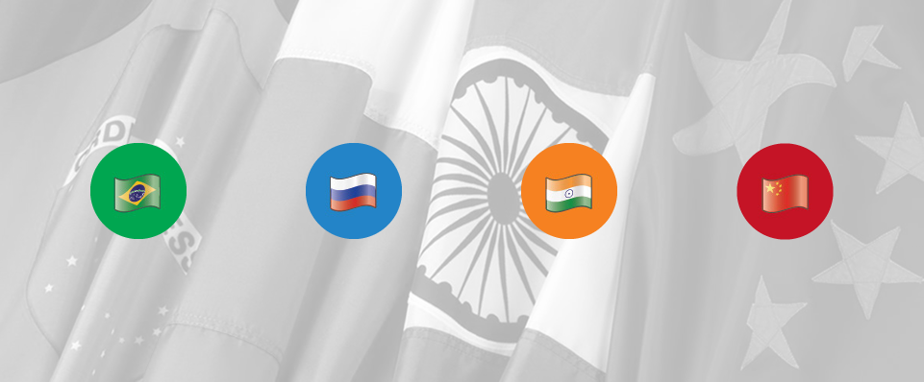
BRIC Markets- Spotlight India
Understanding the New World Traveler

Slide 2
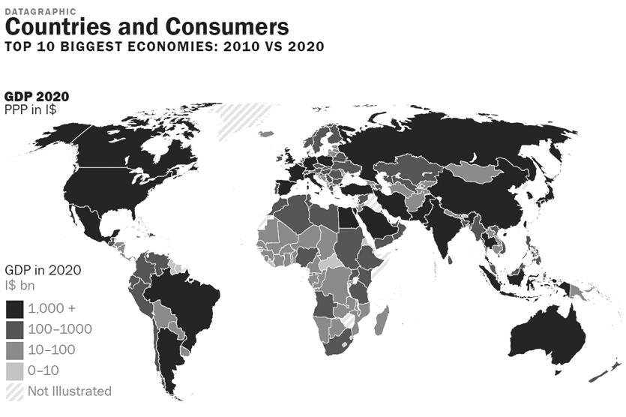
Understanding Market Shifts
Source: Euromonitor Int’l: 2014
Notes:
ALREADY THERE IS A GLOBAL SHIFT IN ECONOMIC POWER
EMERGING MARKETS WILL RISE IN IMPORTANCE BOTH ECONOMICALLY AND POLITICALLY AS WEALTH STARTS TO SHIFT
VOLUME AND VALUE GAINS WILL BE SOUGHT THROUGH BOTH THE EMERGING MARKETS AND DEVELOPED MARKETS OVER THE LONG TERM, CURRENTLY HOWEVER, VALUE IS STILL GOING TO BE FOUND IN DEVELOPED NORTH AMERICAN AND WESTERN EUROPEAN COUNTRIES
CONSUMER MARKETS IN EMERGING ECONOMIES WILL PRESENT ENORMOUS OPPORTUNITIES BUT THIS RAPID GROWTH ALSO POSES A CHALLENGE ON INFRASTUTURE AND THE ENVIRONMENT

Slide 3
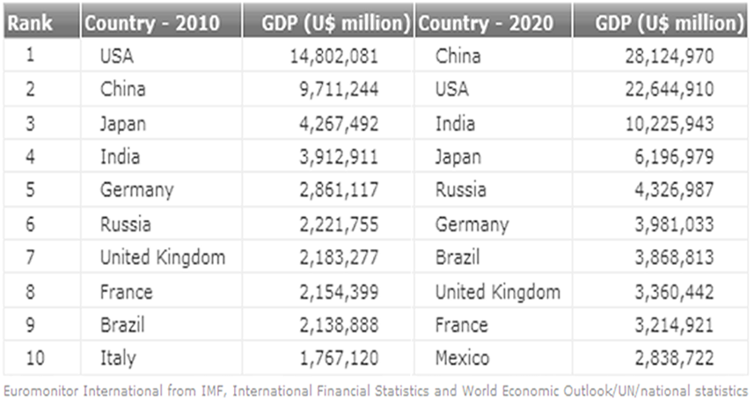
10 Largest Economies by GDP
Notes:
This year China over took the US and has become the world’s largest economy this shift happened 3 years ahead of forecast was for 2017
By 2020 there will be a major shift in the world economic order and there will be more emerging countries in the top 10 economies that will continue to grow.
With huge populations and rising household incomes, the consumers goods and service market in emerging economies will provide enormous opportunities for the tourism industry.
Luxury goods will continue to expand as more people will be able to afford them, in economic terms, the middle class will muscle strong purchasing power – one example is of China where the annual disposable will almost quadruple from 57.1 million a few years ago to over 222 million households by 2020 a rise of 246%
Younger consumers will become more important , despite population aging in several emerging countries including China. However the opposite effect occurs in India where the emerging population is substanitally younger than in advanced economies and youngest in the emerging markets.

Slide 4
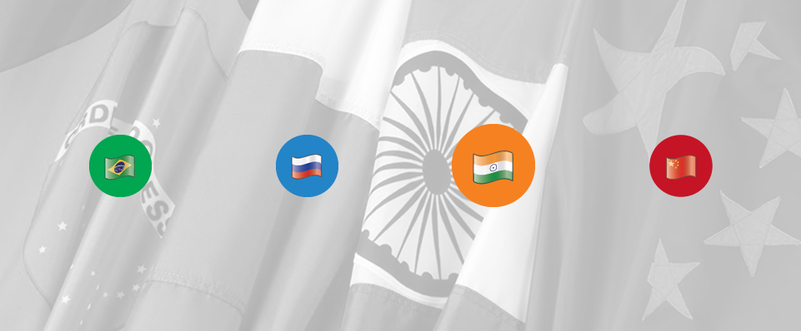
India
Understanding the Indian Traveler

Slide 5
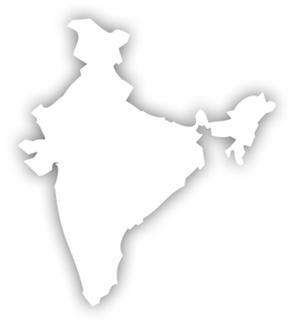
Snapshot India
New Delhi
20.10 million
Mumbai
12.78 million
Population:
1.10 billion
Travel Demographics Reported Mid 2012:
Current major destinations
Recent Growth
To United States:
Outbound Travelers:
2014: 15 million outbound
2020: 50 million (projected)
Youth intensive – median age 26.7
UK
Australia
South Africa
New Zealand
Canada
USA
Thailand
Western Europe
Singapore
2011:
753,000
2013 859,000
Notes:
Age Demographics: 50% under the age of 35 years
Languages: 22 official languages
English widely spoken and the business language
GDP Growth: India maintained an average GDP of 6% in the last 5 years. Current average GDP of 5.5%-6%
Income: Growing middle class – with over450 million people Increase in disposable income

Slide 6
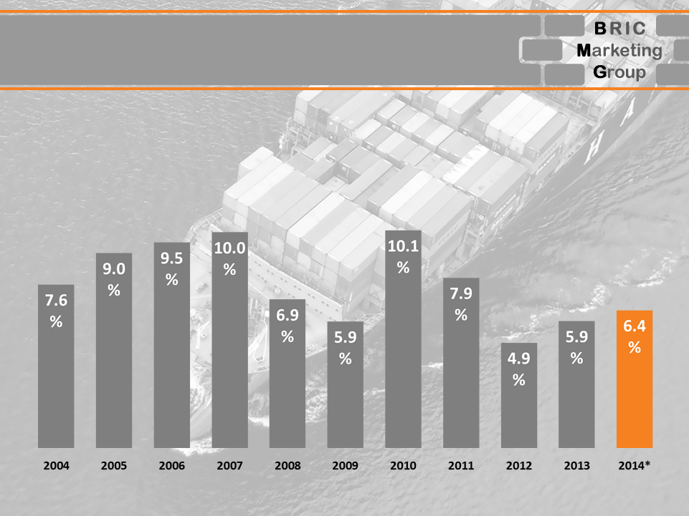
India’s Economy
Source: forbes.com
Notes:
There have been short term worries about the economic outlook of India since 2012. The fluctuating Indian rupee is further compounded by the lower estimates of the gross national product.
However , Indian middle class is expected to reach 267 million people in the next 5 years, up 67% from current levels.
There has been an unprecedented level of wealth in the county and a large increase in the number of ultra rich. Over the next 5 years, a large number of ultra net worth households in the country will more than triple from 100 K to 320 k .
During this period these households wealth are expected to increase 4.5 times. The spending of this new mega-class is enormous.
India is 3rd largest economy in world in Purchase Power Parity
Growing disposable income to increase regardless of soft economic growth
Changing social attitude - seeking quality at the right price plus demand for customized offerings
Social media gives rise to new ways of sharing
Easier accessibility to US destinations via both Europe and Asia

Slide 7
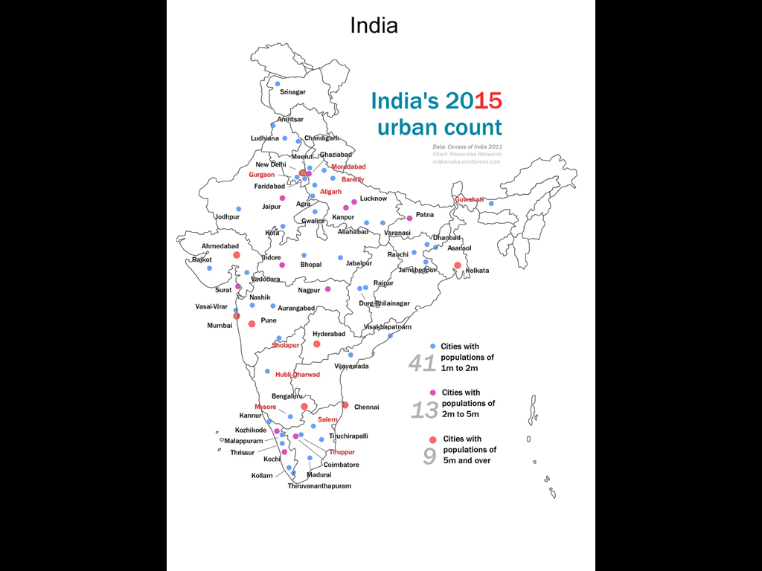
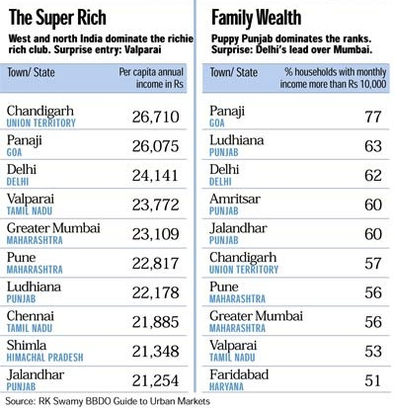
India’s Wealth
PUNJAB
GUJARAT
Notes:
Much like China, India is growing steadily and throughout the country.
There are several Tier 2 cities who are on the Super Rich List.
The states of Gujarat and Punjab are two of the fastest growing regions with higher than average gross income.

Slide 8
India’s Outbound Travel Market
Notes:
Indians are making huge strides in the outbound travel numbers –
50 million passport holders in the country and expected to reach 100 million in 10 years
Currently there are 15 million outbound travelers leaving India with approx. 800k coming to the US this number will reach 50 million by 2020. In % terms, this puts India as the worlds fastest growing market for outbound travel, in pure numbers it is second after China,
Nearly 54% of the high net worth households are based in 4 key metro regions that include Delhi, Mumbai, that account for 70% of the business followed by Bangalore, Chennai, and Hyderabad.
Also there has been an upsurge in affordable international travel packages which is encouraging the countries rising middle class to travel abroad.

Slide 9
India’s Outbound Travel Market
Notes:
WITH ALL THE INDUSTRY EXCITEMENT AROUND CHINA, INDIA IS LIKE THE 800 LB GORILLA IN THE ROOM.
IN THE NEXT 15 YEARS:
India’s middle class will have increased from 5% of the population (60 million) to almost 50% (750 million) by 2030.
Travel expenditure in Asia-Pacific by Indian travellers in the next 15 years is expected to reach US dollars 91.2 billion (as against 13.3 billion in 2011

Slide 10
Indian Arrivals into the USA
18.6%
18%
Notes:
In 2013- 859,169 Indians visited the United States. India ranked 12th in arrivals and was an increase of 19%
Figures for 2014 from Jan-March indicate over 159,000 Indians visited the USA. A growth of 7%

Slide 11
Money Spent by Indians in the USA
Notes:
Indian travelers spent over 5.6 billion dollars in the year ending 2013. India is in the top 10 markets of the USA

Slide 12
AIR LIFT INTO USA
Via Atlantic
American Airlines
Via Pacific
Cathay Pacific
Via Gulf(Middle East)
Emirates Airline
British Airways
Swiss Air
Virgin Atlantic
Turkish Airlines
Lufthansa
KLM Air France/ Delta
Austrian Airlines
Air China
All Nippon Airlines
China Eastern Airlines
China Southern Airlines
Japan Airlines
Singapore Airlines/ Silk Air
Asiana Airlines
Korean Air
Etihad
Qatar
JET Airways
Approx. 90% of Indian travelers arrived in the U.S. through connecting flights from third point.
Notes:
Indians like Australians are used to traveling long distances for holidays. Air India and United offer Non-Stop Service from JFK/Newark and Because of the proximity of the Middle East it has become hub for the Indian market with major carriers growing in this region from all tier 1 and tier 2 cities in India.

Slide 13
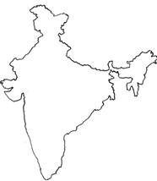
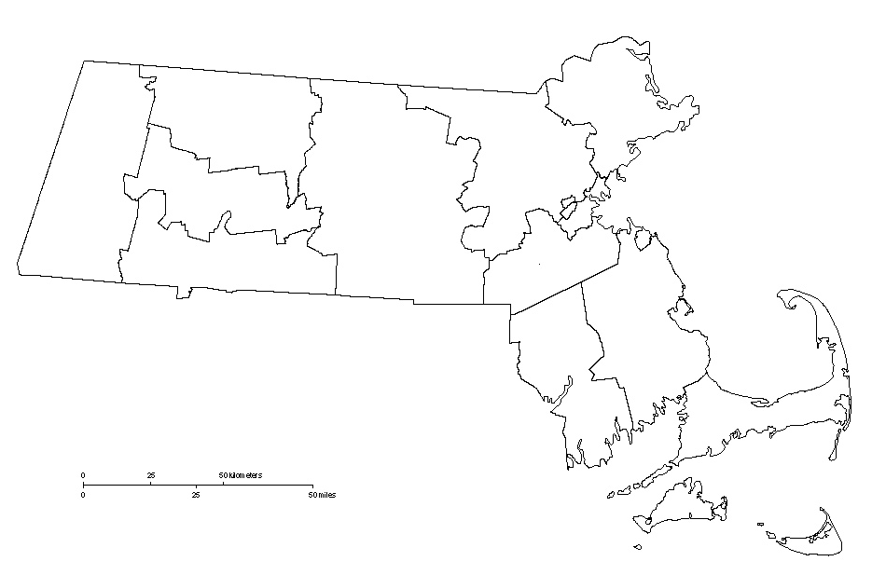
AIR LIFT INTO BOSTON
Notes:
The two major US gateways for the Indian traveler are #1 JFK and #2 SFO-

Slide 14
Family Travel and VFR
Many Indians have associations to the US (through family, school, or business ties)
USA ranks 3rd in their Int’l destination mix
Family holidays rank as the top most objective (91%) followed by visits to family and friends (VFR)
Notes:
One of the leading source market for International students to the USA
Most Indians have some association to the US where they have member of their family or they have gone to school or have business ties. Travel for the Indian market is not dependent on language (most Indians are multi lingual, speaking English, Hindi, and their own cultural dialect)
The USA ranks third in their destination mix of outbound tours, after more short haul markets like SE Asia or Europe.
Family holidays (91%) ranked on top, followed by visits to family and friends (VFR), business/holiday and the honeymoon segment ranked highly.
Indian’s travel in small family groups that consist of 4 – 9 ppl and most popular travel periods are:

Slide 15
Key Motivators
Notes:
Indian travellers are well informed, sophisticated and educated; looking for new destinations/activities and out of the ordinary experiences
Growth in various travel segments specially FIT, Special Interest and MICE
KEY MOTIVATORS:
Leisure and sightseeing are key motivators for International holidays. Major activities preferred-
Sightseeing
Shopping
Food
Entertainment and night life
Adventure & outdoor activities in high demand
There is a new league of younger discerning travellers, who appreciate art and art galleries, musical concerts, designers and local fashion.
Indian consumers much like their Chinese counterparts look for deals at every economic level. It is also good to know that the Indian market is the 6th largest for spending on hotels , ahead of travelers from the UK, France, Germany and even Singapore (Hotel Price Index by Hotels.com)
Also don’t shy away from VFR, as that sort of travel from India is becoming more of an opportunity due to their changing profile. There was a time when Indians went overseas and only stayed with family members, now this is changing and they end up more of the time traveling on their own using a number of tourism products.

Slide 16
Group vs FIT
well-researched
bargains better
keen on DIY itineraries
Notes:
The New Age Indian traveler dislikes tight schedules; prefers booking hotels, flights, tours on their own
There is a significant disconnect between travel trades’ preparedness to handle customer preferences esp. for new generation travellers using latest technologies.
Travel websites and social media rank much higher as travel influencers for consumers while the travel industry feels that their advertising and recommendation create maximum impact.
There is growing preference for free & easy itinerary & non-guided tours vis-à-vis fixed departure group tours;
Intention to travel beyond summer holidays
Willingness to extend the duration of a holiday, spend more, explore countryside, local art & culture and cuisine
The younger generation is also looking for adventure sports and driving holidays – not just traditional sightseeing, shopping and theme parks.

Slide 17
Travel Trade
Notes:
The distribution of travel product from India is fragmented and predominantly retailer based; large agencies only represent less than 10% of the outbound business from India. Most in the hands of the smaller retailer
;
Unorganized Sector- no trade licenses required.
Wholesalers who operate as retailers: 15/20 all India (Including Online Travel Agencies)
Tour Operators: 50/60 all India
Retail Agents: Over 3,000
FIT Travel is showing the highest growth with a growing demand for niche products – off the beaten track locations, outdoors and other unique visits and activities.
With the largest population of young people in the world with more than 650 million under 35and 500 million Indians under the age of 25 , nightlife & theme park tourism is extremely popular.
Major agencies in market are Thomas Cook, Cox & Kings, TUI, Kuoni, SOTC, Make my Trip, India’s version of Expedia. Corporate offices are based in Mumbai and Delhi.
In India the Big Three Operators- Thomas Cook, SOTC/Kuoni and Cox & Kings
Act as wholesalers and retailers
Cater to all markets
Have mass market itineraries
Big marketing bugets
Promote and sell all major global destinations
.

Slide 18
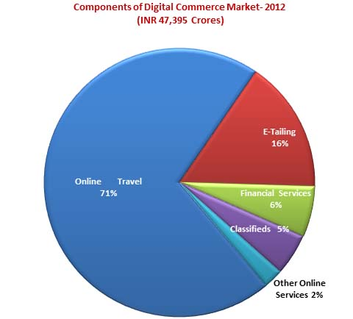
On Line Travel Scenario
Notes:
India – is one of the fastest growing with online travel sales market between 2011 & 2016 - with a compound annual growth rate of 30.6%.
Travel Search Trends [Source: Google India]:
40% Research online Buy Offline
29% Research and Buy Online
50% search were for hotels followed by Air Travel queries (27%), Holidays (10%), Bus & Rail (7.42%) and Car rentals (1.97%)
Online portals offer a range special hotel rates, airlines and joint promotions with tourism boards.
IE-commerce growth mainly driven by online travel industry (share of travel is over 80%) [Source: IAMAI]

Slide 19
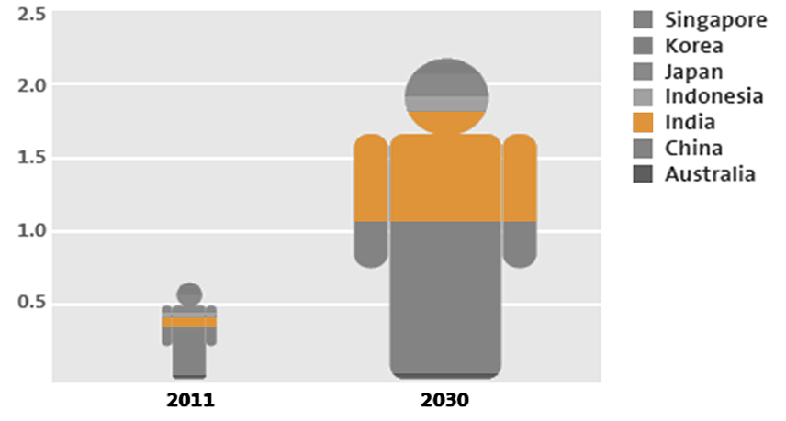
Key Consumer Trends
Asia Pacific Middle Class
Source: ADB. The Rise of Asia’s Middle Class: 2010 (Frost & Sullivan estimates)
Notes:
KEY CONSUMER TRENDS IN INDIA:
The changing profile of the Indian traveler offers great opportunity- the Indian outbound traveler is well informed, sophisticated & educated.
India Visas are good for 10 years for leisure travelers
Credit Card usage gaining popularity
All travel segments growing specially FIT, Special Interest and MICE.
VFR creating opportunities and sustained volumes
Online – an important source for information

Slide 20
Three Reasons to Consider Investing In the India Travel Market
Indians speak, understand and use English as their common tongue
Indians LOVE American Culture and Emulate American lifestyle and living
Given the age demographics, and affinity for the US – there will be a constant mix of first time and repeat travelers for the long haul.

Slide 21
Thank You
Q&A

