Slide 1
LOCALIZATION for Tourism & Hospitality Industries
Yvette Fang
Red & Blue International
Focus On Asia Workshop
by Massachusetts Office of Travel & Tourism (MOTT)

Slide 2
Why This Seminar
The U.S. State Department (2010): The U.S. firms collectively lose out on $50 billion a year due to poor or missing translations.
Pepsi’s “Come alive with the Pepsi generation” was translated in Chinese ads as “Pepsi brings your ancestors back from the grave.”
Authorized to use by Brendan & Brendan

Slide 3
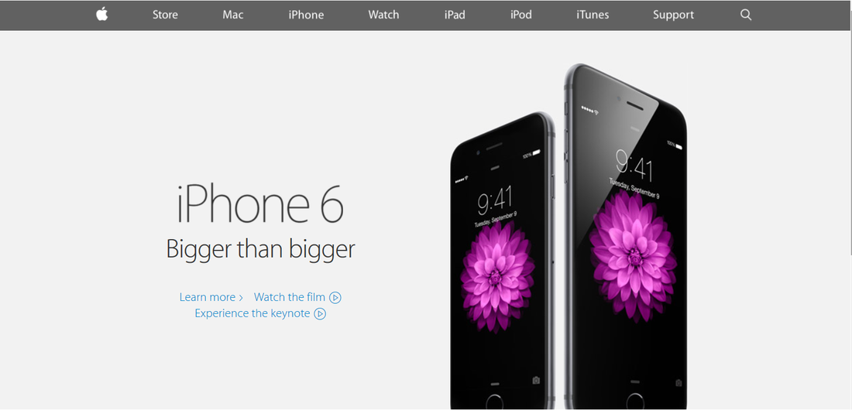
Why This Seminar (continued)
In September 2014, Apple’s Chinese slogan was simply translated word-to-word from English, which caused their Chinese customers to lose confidence in the product.

Slide 4
Localization Industry
Started in 1970s
The localization industry in the U.S. market reached nearly $40 billion – Common Sense Advisory
The 4th fastest-growing industry in the U.S. – The Centre for Next Generation Localisation

Slide 5
Localization is an ART
Localization is the customization of all components of a service/product for a particular target market.
Beyond word-to-word translation
Reflect the original intent of allusion, colloquialism, slang and other nuances
Adapt to local culture and custom
To replace it with an Asian case study.
Chinese colors.

Slide 6
Machine Translation?
Not professionally yet!
Google Translate
English |  | Chinese |  | English
“Bigger than bigger.” |  | 大于大。 |  | More than big.
English |  | Japanese |  | English
“Assume Nothing.” |  |  |  | Let's assume anything.
English |  | Korean |  | English
“Come alive with the Pepsi generation.” |  |  |  | Cobran life con la generación Pepsi.

Slide 7
Localization is a SCIENCE
Workflow Management
Cost Effective
Glossary
TM

Slide 8
What to Localize
Marketing materials: brochures, fliers, websites
Promo videos
Client meetings
Phone prompts
Legal Contracts
Add an Asian bustle street picture

Slide 9
How to Order Localization Services
Integrate localization into the process from the very beginning
Glossary and Style Guide
Proofreading and review

Slide 10
How to Have Video Localized
Methods
Script Localization & Voice Recording
or
Subtitle Localization
Keys
Rewriting: time codes, culture, language
Talent: voice, tone, style
Monitor

Slide 11
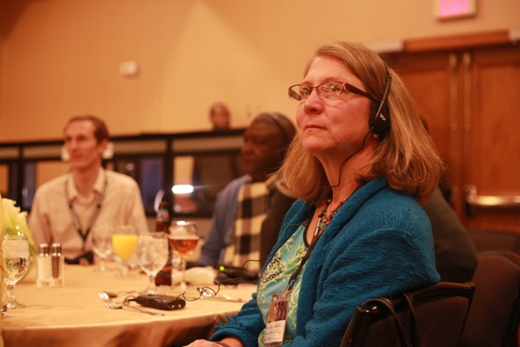
Work together to keep the businesses in Mass.!
Why Massachusetts and Boston
Education, institutes, finance, investment
Sightseeing, shopping
……
Unite, Network, Refer, and Keep the businesses with the state
Hotel to refer event planners and interpretation services
Globalization solutions providers to refer accountants
Accountants to refer bankers

Slide 12
Happy New Year of the Goat!
Yvette Fang
CEO, Red & Blue International
yfang@redblueint.com
617. 945. 7083
@REDBLUEINT
REDBLUEINT

